Slide 1

AAA School of Advertising
DIGITAL LIBRARY
USER GUIDE 2023
Access Methods
At Campus/Remote Access

Slide 2

Digital Library
AAA School of Advertising has subscribed to various digital libraries to enhance research, teaching & learning.
These are available to staff and students online and can be used anywhere, anytime.
The digital libraries have various features to enhance the user experience.

Slide 3

EBSCO
EBSCO is the leading provider of research databases, e-journals, magazine subscriptions, e-books and discovery service to libraries of all kinds.
EBSCO has partnered with libraries to improve research with quality content and technology. The institution has access to Business Source Complete which is the world's definitive scholarly business database, providing the leading collection of bibliographic and full text content.

Slide 4
EBSCO Login Details:
Click on link below to access Business Source Complete or via moodle:
https://search.ebscohost.com/
User ID: richfield
Password: Access1+

Slide 5
EBSCO Connect portal
There also is an EBSCO Connect portal that can be used for training and student orientation. Below are some of the tutorials and user guides that may be a great start:
How to create personal account?
EBSCO Mobile
EBSCOhost basic searching

Slide 6


Emerald e-Journals
Emerald Publishing is one of the world's leading digital-first publishers, commissioning, curating and showcasing research that can bring about real change.
They work with thousands of universities and business schools across the world, to share knowledge and bringing research to life.
Journal articles are peer-reviewed.

Slide 7
Accessing Emerald Publishing
Emerald Insight can be accessed at campus through IP Address Authentication.
When not at campus, users can set up their accounts by using the Organizational Activation Number (OAN).

Slide 8
Organizational Activation Number (OAN)
The OAN access code enables username and password access to Emerald Insight.
To activate, new users will need to register a profile on emerald platform and then enter the below Organizational Activation Number (OAN) when prompted.
If a user profile already exists then, once signed in, they will be able to link the OAN directly to their profile.
OAN access code:OAN: 404518944833128
Expiry date: 28/02/2024

Slide 9
Instructions for OAN Use
Register a profile on the Emerald platform
From the homepage: www.emerald.com/insight) select “Register”
Enter your name, e-mail address and OAN
Tick to agree to the T’s & C’s And Privacy Policy, Then click "Register"

Slide 10

Instructions for OAN Use
You will then receive an e-mail asking you to activate your account:
You must click on the “Login” Link

Slide 11
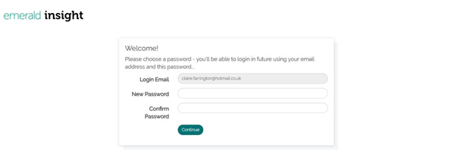
Instructions for OAN Use
You will then be directed to a welcome page where you will need to create and confirm your password:
After assigning a password, click "continue"

Slide 12
Instructions for OAN Use
You will be taken to the Emerald Insights homepage and be authenticated for access to this institution’s Emerald subscriptions.
If you click on the 'products' page, you will be able to see to which products we can access.
Alternatively, you can begin searching from the search bar.
Results can be streamlined to ‘only content i have access to’ on the results page itself.
You will be able to save your searches to your profile, so that you can perform the same searches on your next visit.

Slide 13
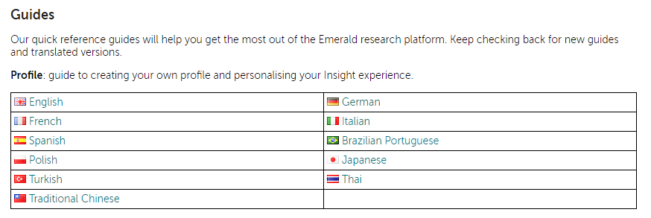
Emerald Search Details
Go to Emerald Search Guides for more details and information on how to make maximum use of this research platform:
https://www.emeraldgrouppublishing.com/support/training.htm

Slide 14
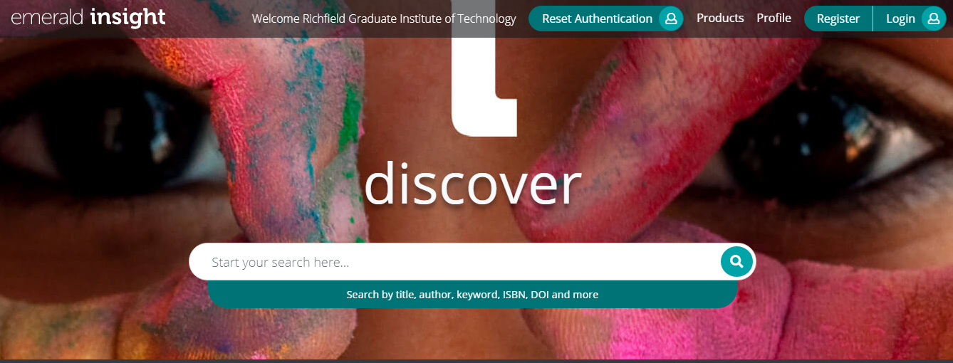
Navigating Emerald-Fixed IP Address Authentication
Log on to: https://www.emerald.com/insight/

Slide 15
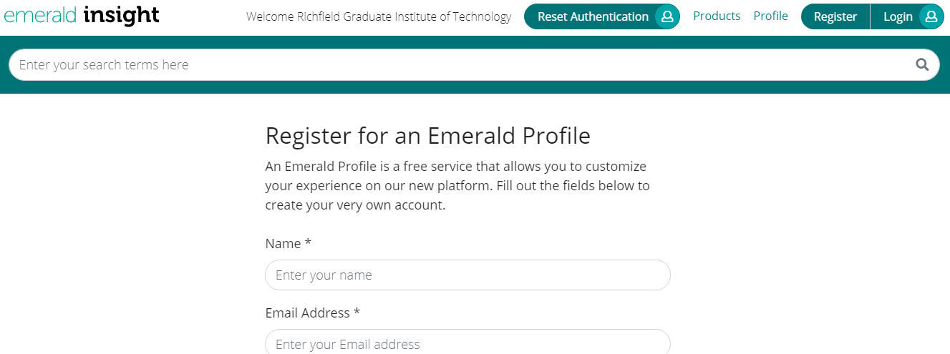
New User Registration
Click on register next to log in.
Select new user registration to create your unique username and password.

Slide 16
Emerald e-Journal Collection
The institution has access to all Emerald e-journal collections and consists of the following subject areas:
Accounting, Finance & Economics
Business, Management & Strategy
HR, Learning & Organizational Studies
Information & Knowledge Management
Marketing
Operations, Logistics & Quality
Property Management & Built Environment
Public Policy & Environmental Management
Tourism & Hospitality

Slide 17
Emerald e-Journal Collection
Specialist e-journals portfolio consists of the following:
Education
Engineering
Health & Social Care
Library Studies

Slide 18
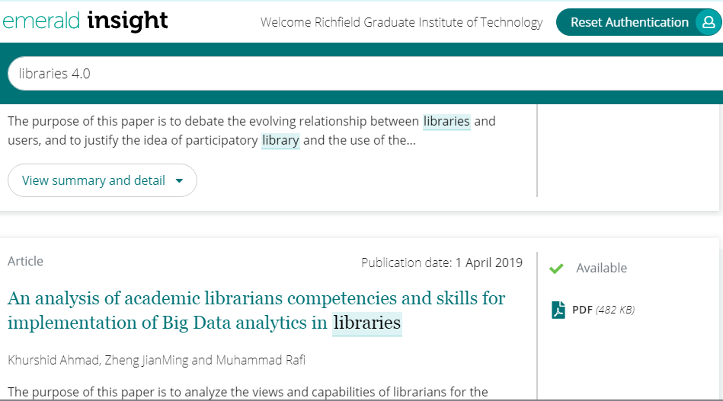
Selecting The Journal
Select the journal article.
We have access to journals with a green tick next to it.

Slide 19
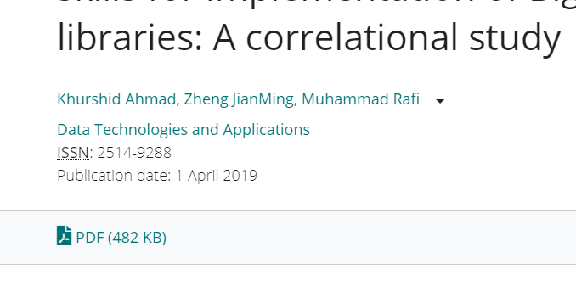
Downloading Journals
Select the journal article that you would like to download.
Select pdf in order to download the journal.

Slide 20
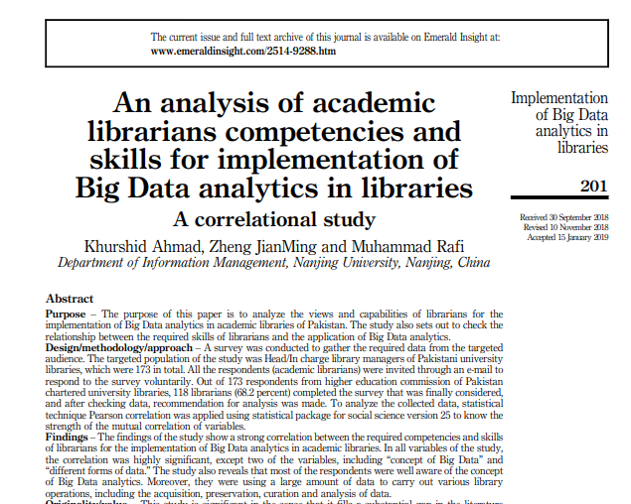
Saving the Journal
The journal article can be saved or printed.
You can also share with colleagues.

Slide 21
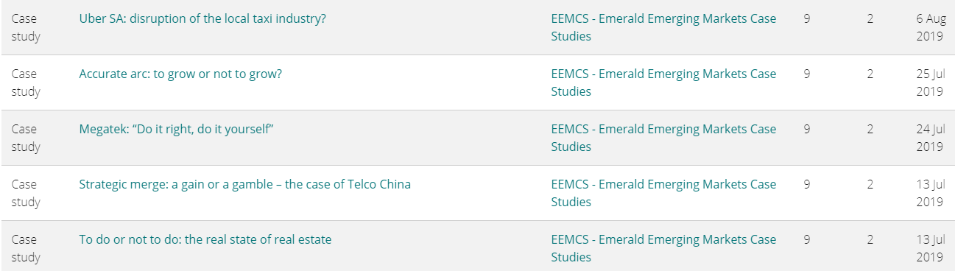
Emerald Emerging Markets e-Case Collection
The institution has access to emerald emerging markets e-case collection.
E-cases are also known as electronic case studies.

Slide 22
Emerald Emerging Markets e-Case Collection
Subjects include:
Accounting & Finance
Built Environment
Entrepreneurship
Environmental Management
Human Resource Management
International Business
Management Science
Marketing
Operations & Logistics
Public Sector Management
Strategy
Tourism & Hospitality

Slide 23
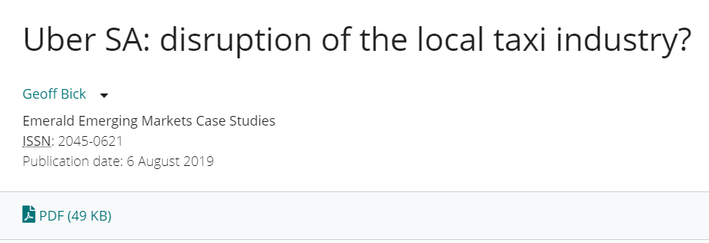
Emerald Emerging Markets e-Case Collection
Emerging Markets case studies is a digital collection of peer-reviewed teaching case studies focusing on business decision making and management in global markets.

Slide 24

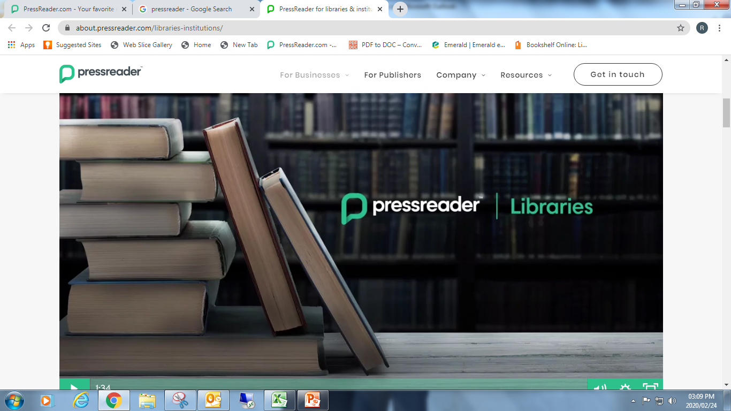
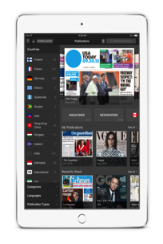
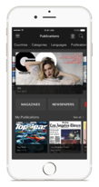
PressReader Connecting People through News

Slide 25
Pressreader e-Newspapers/Magazines
Pressreader offers unlimited digital access to over 3500 top newspapers and more than 3400 magazines. choose from full-version, current-day content in 60+ languages from more than 100 countries.
Students can enjoy reading the world’s newspapers and magazines the way they want to receive them - in print, online, or on their mobile device, tablet or e-reader - wherever they live, travel, work or play.
Plus, download complete issues of thousands of top newspapers and magazines just as they appear in print.

Slide 26
Navigating PressReader
Click on link: http://www.pressreader.com/
This gives access to staff and students when at campus only.
Pressreader can be accessed through moodle or the 14 days radiant access when not at campus.

Slide 27
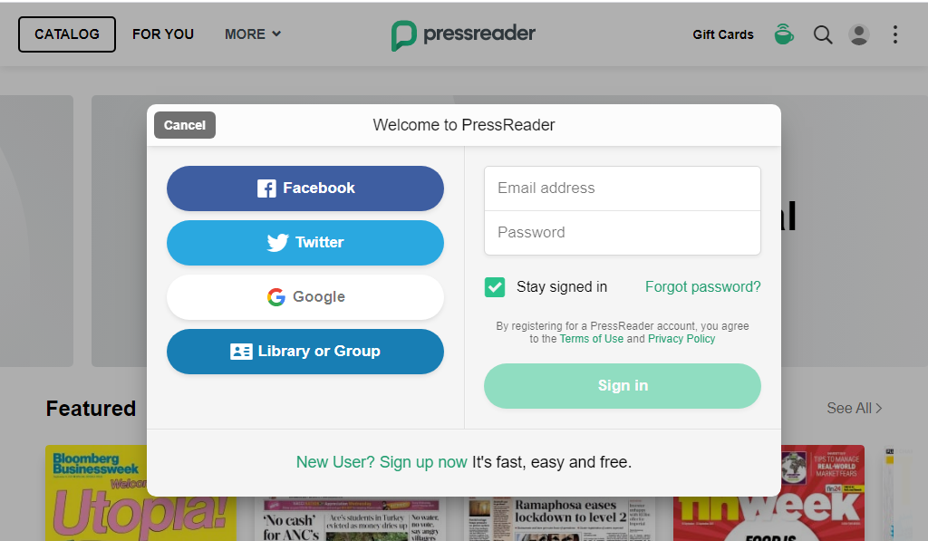
Signing In & Registration
New users to sign up with email address and create password.
You need to register to personalise your press reader experience

Slide 28
PressReader App
Pressreader enables you to download your favourite publication to your pc, mac, mobile device, tablet or e-reader, allowing you to read publications when you are without an internet.
Important: please review the system requirements before downloading and installing pressreader.
Students can download the pressreader app to get an endless stream of top news stories in a personalized home feed.

Slide 29
14 Days Radiant Access
Pressreader can be accessed off campus by using the 14 days radiant access.
This is simply an extension of the IP authentication, meaning after they leave the “hotspot”, they have 14 days of remote access; after 14 days, they need to return to the campus and re-connect to the network to extend for an additional 14 days.

Slide 30
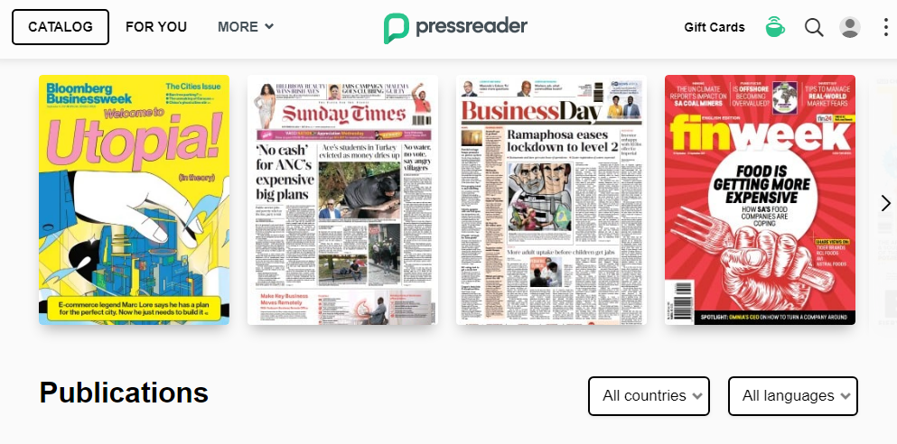
Selecting Publications
Click on countries or browse and select any publication you would like read.

Slide 31
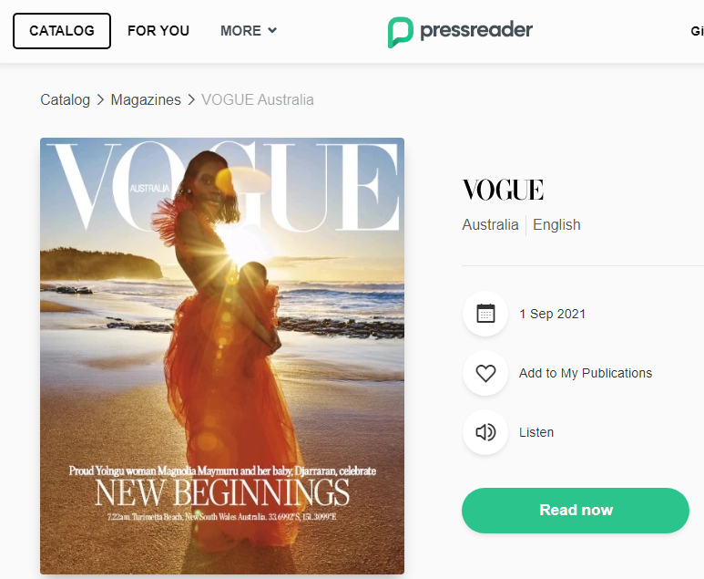
Selecting a Newspaper or Magazine
Click on article you would like to read:

Slide 32

Springer Nature e-Books
The institution has partnered with International Publisher, Springer Nature, to make available over 3000 new titles of 2018/2015 editions of a series of e-books free of charge to registered students in the following fields:
Business
Management
Computer Science
Economics
Finance
Mathematics
Statistics
Professional Computing
Applied Computing

Slide 33
Springer Nature e-Books in Business & Economics
The portfolio of Business and Economics books comprise of science monographs, handbooks, book series and textbooks in all subject areas.
Click on link below to access 2018 collection:
https://link.springer.com/search?package=41169&facet-end-year=2018&facet-start-year=2018&facet-content-type=%22Book%22
Click on link below to access 2015 collection:
http://link.springer.com/search?package=11643&facet-end-year=2015&facet-start-year=2015&facet-content-type=%22Book%22

Slide 34
Springer Nature e-Books in Computer Science
The Computer Science offers latest in cutting-edge research to prepare students for an impactful career in computer science.
Click on link below to access 2018 collection:
https://link.springer.com/search?package=11645&facet-end-year=2018&facet-start-year=2018&facet-content-type=%22Book%22
Click on link below to access 2015 collection:
http://link.springer.com/search?package=11645&facet-end-year=2015&facet-start-year=2015&facet-content-type=%22Book%22

Slide 35
Springer e-Books Economics & Finance
The Economics and Finance e-book collection features cutting-edge research from renowned authors and nobel laureates.
Click on link below to access 2018 collection:
https://link.springer.com/search?package=41170&facet-end-year=2018&facet-start-year=2018&facet-content-type=%22Book%22
Click on link below to access 2015 collection:
http://link.springer.com/search?package=11643&facet-end-year=2015&facet-start-year=2015&facet-content-type=%22Book%22

Slide 36
Springer e-Books Mathematics & Statistics
The Mathematics and Statistics ebook collection is world-renowned and has published many bestselling textbooks, monographs and reference works.
Click on link below to access 2018 collection:
https://link.springer.com/search?package=11649&facet-end-year=2018&facet-start-year=2018&facet-content-type=%22Book%22
Click on link below to access 2015 collection:
http://link.springer.com/search?package=11649&facet-end-year=2015&facet-start-year=2015&facet-content-type=%22Book%22

Slide 37
Springer e-books Professional & Applied Computing
The Professional and Applied Computing e-book collection includes a collection of apress book titles dedicated to meeting every level of educational and informational needs of developers, it professionals, and tech communities worldwide.
Click on link below to access 2018 collection:
https://link.springer.com/search?package=12059&facet-end-year=2018&facet-start-year=2018&facet-content-type=%22Book%22
Click on link below to access 2015 collection:
http://link.springer.com/search?package=12059&facet-end-year=2015&facet-start-year=2015&facet-content-type=%22Book%22

Slide 38
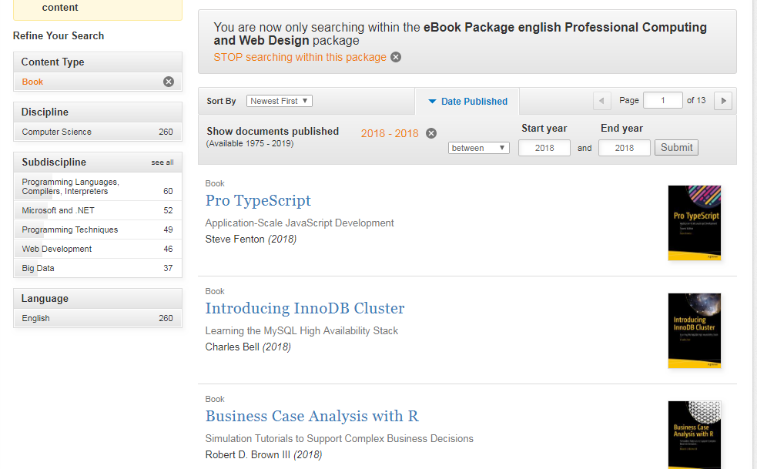
Selecting e-Books
Select e-book you would like to download:

Slide 39
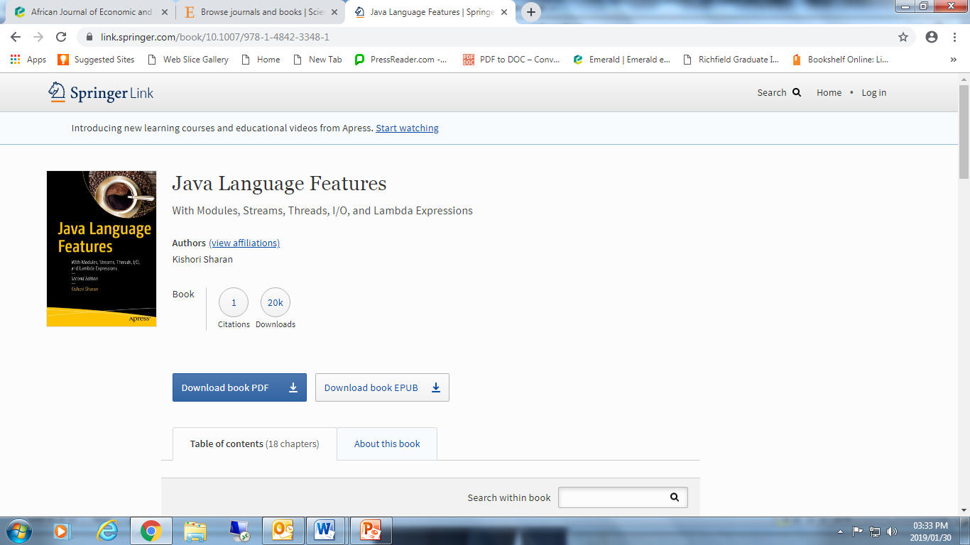
Downloading e-Book
Click on download:

Slide 40
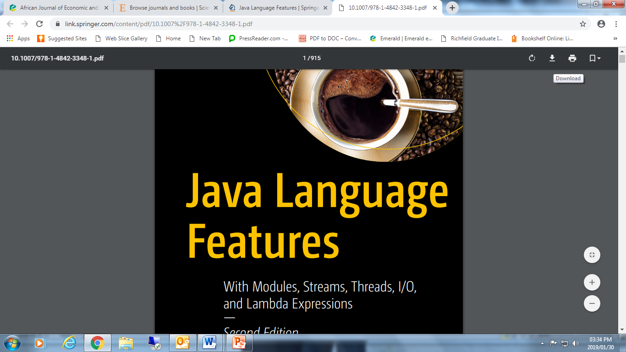
Download Complete
The book can be read, printed or saved on your computer and shared with other colleagues.

Slide 41
Elsevier ScienceDirect e-Book Collection
The institution has perpetual access to Elsevier ScienceDirect 2012-2018 e-book collection.
The e-book collection consists of the following subject areas:
Computer Science
Engineering
Mathematics
Social Science
Business, Management, Hospitality and Tourism
Finance
Media Technology
Medicine and Dentistry

Slide 42
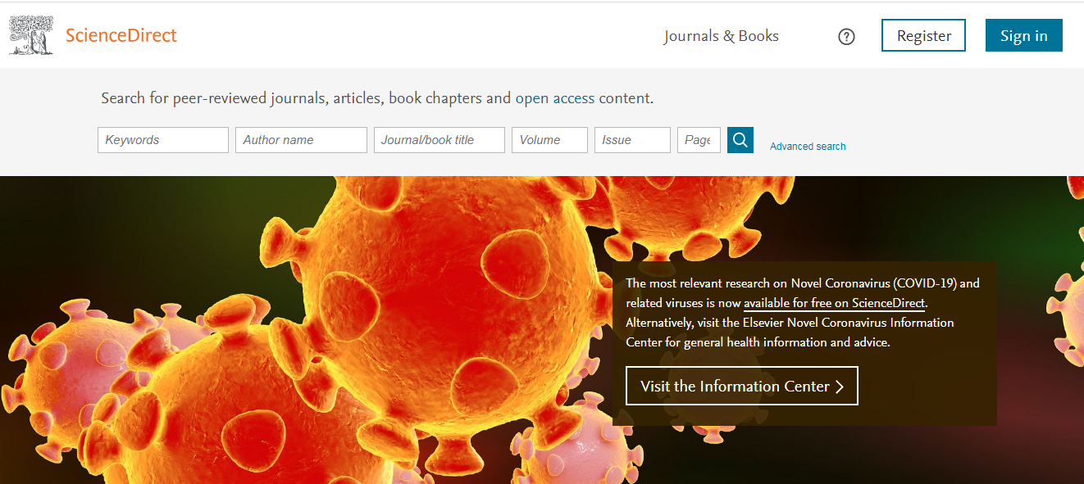
Campus Access
The e-book collection can be accessed through IP Address Authentication at campuses.campuses.
Click on link: www.ScienceDirect.com

Slide 43
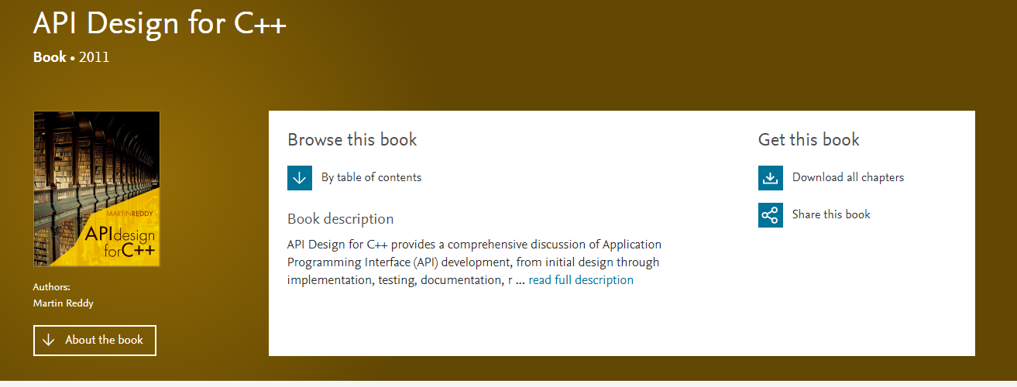
Selecting an e-Book
The entire e-book can be downloaded or selected chapters:

Slide 44
Digital Library Benefits
How do students benefit?
Hassle free: no set up or maintenance required.
Simple: easy access to digital resources.
Convenient: download your favourite article and read anywhere, anytime.
Enjoyable: enhanced with unique digital features that students will enjoy an interactive virtual reading experience.
Selection: students have access to a wide range of digital resources that can be used for research, teaching & learning.

Slide 45
Please Note
Please note that “e-libraries” are available on campuses using the free wifi.
To access “e-libraries” out of campuses and at your own cost, using 3g or other wifi sources, please log onto the moodle portal as follows:
https://learning.aaaschool.ac.za/

Slide 46
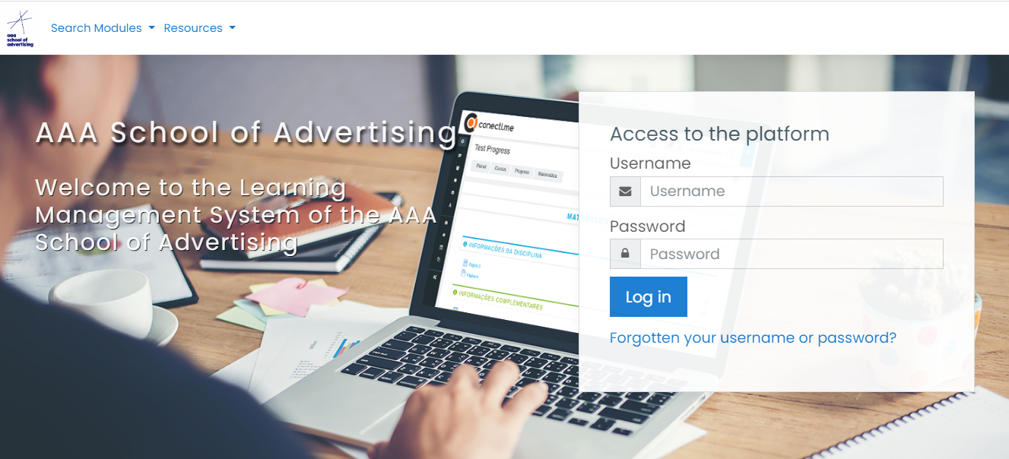
Accessing Moodle
Click on link: https://learning.aaaschool.ac.za/
Enter your unique username and password and to log in

Slide 47
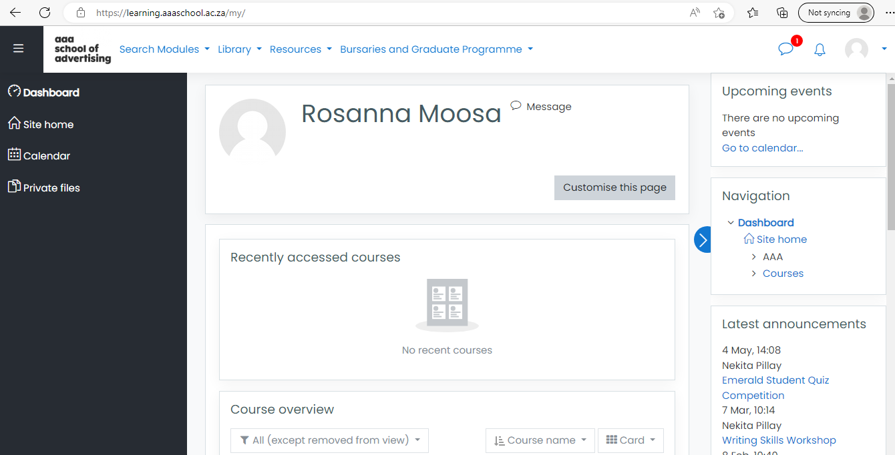
Accessing The Digital Library
Select the tab “Library”

Slide 48
Thank You
Kindly contact the
National Librarian: Mrs Rosanna Moosa
for Remote Access to Springer and Elsevier ScienceDirect e-books
rosanna.moosa@growth-ten.com

Slide 49


